Slide 1
Management Mechanisms

Slide 2
Registry
The registry is a hierarchical database that stores low-level settings for the Microsoft Windows operating system and for applications that opt to use the registry.
The kernel, device drivers, services, Security Accounts Manager (SAM), and user interface can all use the registry.

Slide 3
Purpose of Registry Key
The Windows Registry serves as an archive for collecting and storing the configuration settings of Windows components, installed hardware/software/application and more.
The registry is a hierarchical database that contains data that is critical for the operation of Windows and the applications and services that run on Windows

Slide 4
Structure ( Key & values, Hives)
The data is structured in a tree format.
Each node in the tree is called a key.
Each key can contain both sub keys and data entries called values.

Slide 5
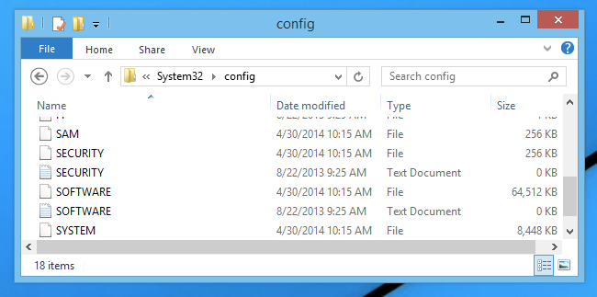
Locations (Demo)
C:\Windows\System32\config\RegBack

Slide 6
Backup and Recovery
Steps to take computer backup.
Open registry window.
Right click on computer.
Click export.
Type the file name as you want.
Click on save.

Slide 7
Recovery
Steps to take computer backup.
Open registry window.
At File, click the Import option
At the Import Registry File screen, browse and select the backup file you want to restore
Click Open

Slide 8
Device Management
A device driver is a small piece of software that tells the operating system and other software how to communicate with a piece of hardware.
operates or controls a particular type of device that is attached to a computer.

Slide 9
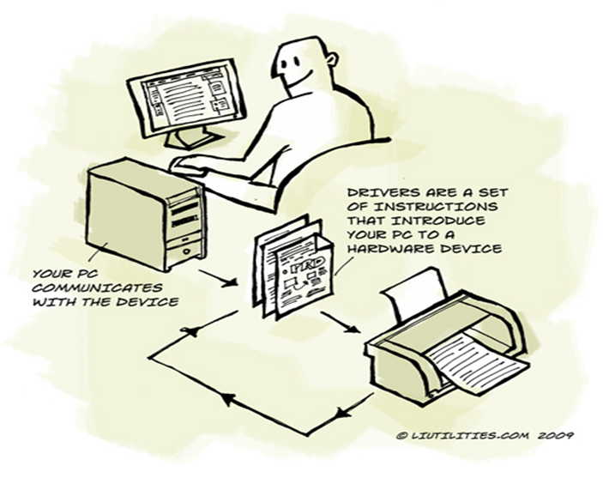
Device drivers
They act as intermediate between operating system and hardware components.
Drivers are packages provided by manufactures (vender) of hardware.

Slide 10
Device controller
A device controller is a part of a computer system that makes sense of the signals going to, and coming from the CPU.
Any device connected to the computer is connected by a plug and socket, and the socket is connected to a device controller.
Device controller plays a Important role in operations of particular Device.

Slide 11
Services
The Services console (services.msc) lets you disable or enable Windows services.
These are system-level programs that typically start when Windows boots up.
Services run even when no user is logged in to Windows.

Slide 12
Functions of Service.msc
Start services
Stop
Disable
Displays all the process that are in Execution
We can set startup type for processes.
Refresh

Slide 13
Windows Services
Active Directory Service
DNS Client Service
Computer Browser Service
Internet Connection Sharing (ICS) Service
Routing and Remote Access Service

